Slide 1

Image Source: https://innovationatwork.ieee.org/real-life-edge-computing-use-cases/

Slide 2
Edge
Upsides
Faster response time for those applications that require it
Slows growth of long-haul connections to processing and storage centers (expensive)
Downside
Security
Can be single point of failure

Slide 3
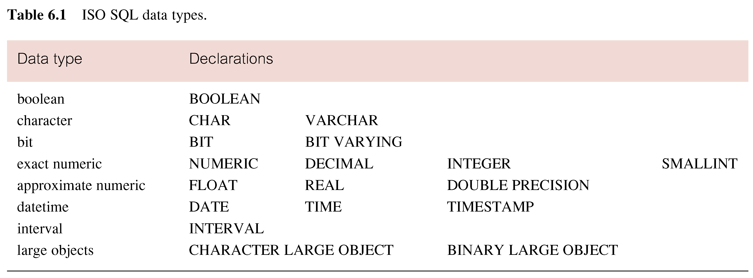
More details -- Domain for attributes: Data type and size
Also, there are
arithmetic, scalar operations and functions (p180)
NCHAR NVARCHAR (allow storing unicode)
Address
UID
Birthdate
RedemptionTime
LastName
Revenue

Slide 4
More details: Create Domain and Domain Constraints
Create Domain (a set of legal value for the attribute)
(some attributes may share the same domain)
CREATE DOMAIN AddressType as NCHAR(50)
Address1 AddressType
Address2 AddressType
Domain Constraints
CREATE DOMAIN … CHECK
CREATE DOMAIN DomainName [AS] dataType
[DEFAULT defaultOption] [CHECK (searchCondition)]
CREATE DOMAIN GenderType AS CHAR
DEFAULT ‘M’ CHECK (VALUE IN (‘M’, ‘F’))

Slide 5
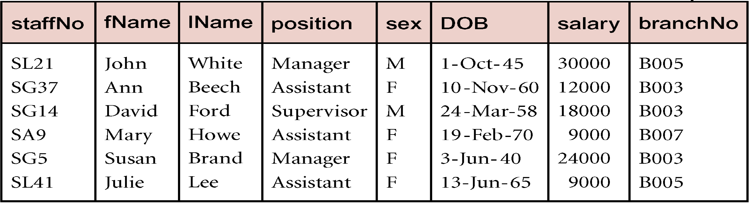
Domain Constraints and Search Condition
searchCondition can involve a table lookup:
CREATE DOMAIN BranchNo AS CHAR(4)
CHECK (VALUE IN (SELECT branchNo FROM Branch));
Constrain value of BranchNo attribute in Staff table

Slide 6
More Details: Entity Integrity Constraints & Required Data
Required Data for specific attribute
position VARCHAR(10) NOT NULL
ISO standard supports definition of primary keys with PRIMARY KEY clause:
PRIMARY KEY (staffNo)
PRIMARY KEY (clientNo, propertyNo)
Can ensure uniqueness of alternate keys with UNIQUE
isbn13 CHAR(13) NOT NULL,
UNIQUE (isbn13)
Defining a composite key

Slide 7
Referential Integrity Constraints
ISO standard supports definition of foreign keys with FOREIGN KEY clause in CREATE and ALTER TABLE:
FOREIGN KEY (branchNo) REFERENCES Branch
Referential actions on DELETE and UPDATE
CASCADE
SET NULL
SET DEFAULT
NO ACTION – the default option (if no explicit statement)
Example – the PropertyForRent table:
FOREIGN KEY (staffNo) REFERENCES Staff ON DELETE SET NULL
FOREIGN KEY (ownerNo) REFERENCES Owner ON UPDATE CASCADE

Slide 8
Define FK(s) within each table
CREATE TABLE Staff (
staffNo NCHAR(10),
fName NCHAR(20),
lName NCHAR(20),
position NCHAR(20),
sex NCHAR(1),
DOB DATETIME,
salary NUMERIC(10) ,
branchNo NCHAR(10),
PRIMARY KEY (staffNo),
FOREIGN KEY (branchNo) REFERENCES Branch(branchNo));
The NCHAR data type is a fixed-length character data type that supports localized collation. The NVARCHAR data type is a varying-length character data type that can store up to 255 bytes of text data and supports localized collation.

Slide 9
General Constraints (Optional)
CREATE ASSERTION and CHECK the assertion
CREATE ASSERTION AssertionName
CHECK (searchCondition)
Example
CREATE ASSERTION StaffNotHandlingTooMuch
CHECK (NOT EXISTS (select_staff_handling_too_much))
List the staffNo of staff who are handling more than 100 properties
Will return error if u assigned more than 100 properties to a staff
Notes:
ASSERTION … CHECK vs. simple CHECK. – if multiple tables are involved in a general constraint, ASSERTION would be better than duplicating the check in each table

Slide 10
Integrity Enhancement Features
Summary on textbook. I did not follow the order but covered all in all 3 parts above
Consider five types of integrity constraints:
Domain constraints
Required data (not null)
Entity integrity
Referential integrity
General constraints

Slide 11
Example 7.1: CREATE TABLE
PropertyForRent table
Write scripts in 4 Steps: from basic to advanced
1
2
CREATE TABLE PropertyForRent (
propertyNo PNumber NOT NULL, ….,
rooms PRooms NOT NULL DEFAULT 4,
rent PRent NOT NULL DEFAULT 600,
ownerNo OwnerNumber NOT NULL,
staffNo StaffNumber
CONSTRAINT StaffNotHandlingTooMuch CHECK ( … ),
branchNo BranchNumber NOT NULL,
PRIMARY KEY (propertyNo),
FOREIGN KEY (staffNo) REFERENCES Staff
ON DELETE SET NULL
ON UPDATE CASCADE, …. );
5
3
4

Slide 12
Example 7.2: ALTER TABLE
Add a column to Client table. How about Drop?
Remove constraint from PropertyForRent that staff are not allowed to handle >100 properties. How about Add?
ALTER TABLE Client
ADD prefNoRooms PRooms;
ALTER TABLE PropertyForRent
DROP CONSTRAINT StaffNotHandlingTooMuch;

Slide 13
Example 7.2: ALTER TABLE
Change Staff table by removing default value for position column and setting default for sex column to female (‘F’).
ALTER TABLE Staff
ALTER position DROP DEFAULT;
ALTER TABLE Staff
ALTER sex SET DEFAULT ‘F’;
Alter attribute property

Slide 14
DROP TABLE
Is there difference between delete all rows and drop table?
DROP TABLE TableName [RESTRICT | CASCADE]
DROP TABLE PropertyForRent;
Removes named table and all rows within it.
With RESTRICT, if any other objects depend for their existence on continued existence of this table, SQL does not allow request.
With CASCADE, drops all dependent objects recursively.
Is there difference between delete all rows and drop table?
Yes, empty house vs. no house
Similar to NO ACTION in
ON DELETE

